Slide 1
Game Prototype
Ben, Sundar, Mandar, Rajessen

Slide 2
Menu
Levels
Characters
Abilities
Leaderboards

Slide 3
Level 1
Low frequency of crossing animals
Lower difficulty of questions
Lower skill of goal keeper
Prototype:

Slide 4
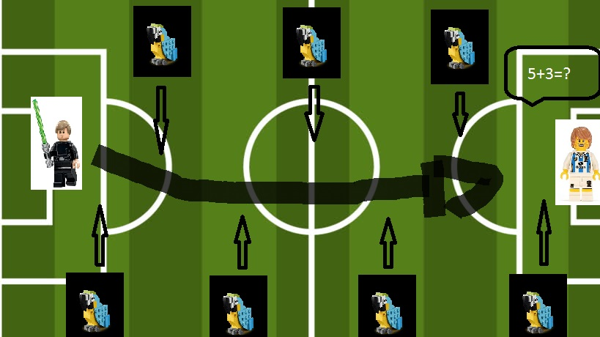
Level 1

